Slide 1


CANCER MORTALITY RATE PREDICTION
Vaibhav Ojha - 230041036
Deepanshu Gupta - 230041008
Harshith Ganji - 230041010
1

Slide 2
OVERVIEW
Abstract
EDA
Introduction
Methodology
Objective
SHAP Analysis
Data Overview
Result
Data PreProcessing
Conclusion
2

Slide 3
ABSTRACT
This study examines how income, education, and healthcare access affect cancer death rates across U.S. counties. Using data from 3,047 counties (2010-2016), we analyzed socioeconomic factors like poverty levels, education rates, and health insurance coverage.
Advanced statistical methods revealed three key findings:
Education matters most: Counties with more college graduates had 1.8% lower cancer deaths.
Healthcare access saves lives: Areas with higher private insurance coverage showed reduced mortality.
Income plays role: Southern states and poorer counties consistently had higher death rates.
3

Slide 4
INTRODUCTION
In this project, we develop a comprehensive regression pipeline aimed at predicting the cancer mortality rate per 100,000 people across U.S. counties. The work reinforces key concepts from our regression analysis course while incorporating modern machine learning techniques to enhance predictive performance. The pipeline includes thorough data preprocessing, implementation of various models.
4

Slide 5
OBJECTIVE
Build a regression-based machine learning model to predict the cancer mortality rate per 100,000 population across U.S. counties.
Apply and compare multiple regression techniques
Understand which factors (e.g., education, income, etc.) most significantly impact mortality
5

Slide 6
DATASET OVERVIEW
ROWS: 3,047 US COUNTIES
FEATURES: 34 VARIABLES
TARGET: TARGET_DEATHRATE (AGE-ADJUSTED MORTALITY
KEY FEATURES
Cancer counts and rates
avgAnnCount: Average annual number of new cancer cases
avgDeathsPerYear: Average number of cancer deaths per year
TARGET_deathRate: The mean cancer mortality rate (per 100,000 people) between 2010–2016 (this is the project’s target variable)
incidenceRate: Cancer incidence rate (new cases per 100,000 people)
Demographics & Socioeconomics
medIncome: Median household income (dollars)
popEst2015: Estimated county population in 2015
povertyPercent: Percent of residents below the poverty line
AvgHouseholdSize: Average household size
BirthRate: County birth rate (per 1,000 people)
Education (by age group)
PctNoHS18_24,PctHS18_24,PctSomeCol18_24, PctBachDeg18_24
PctHS25_Over, PctBachDeg25_Over
Employment & Insurance Coverage
PctEmployed16_Over, PctUnemployed16_Over
PctPrivateCoverage, PctPrivateCoverageAlone, PctEmpPrivCoverage
PctPublicCoverage, PctPublicCoverageAlone
6

Slide 7
DATA PREPROCESSING
OUTLIER TREATMENT
MethOD: STATISTICAL FILTERING USING THE 3-SIGMA RULE APPLIED TO EACH NUMERICAL COLUMN.
JUSTIFICATION: REMOVES EXTREME VALUES THAT COULD SKEW MODELS—ESPECIALLY SENSITIVE ONES LIKE OLS.
IMPLEMENTATION: CUSTOM FUNCTION LOOPS THROUGH COLUMNS, CALCULATES BOUNDS, AND FILTERS ROWS.
IMPACT: ~2.6% OF ROWS WERE REMOVED, RESULTING IN A CLEANER, MORE ROBUST DATASET.
HANDLING MISSING VALUES
MethOD: MISSING VALUES ARE IMPUTED WITH 0 AFTER VALIDATING IT DOESN'T INTRODUCE BIAS.
JUSTIFICATION: QUICK AND CONSISTENT IMPUTATION THAT MAINTAINS DATASET SIZE AND INTEGRITY.
IMPACT: ENSURED SMOOTH MODELING WITHOUT INTRODUCING STATISTICAL ARTIFACTS.
7

Slide 8
DATA PREPROCESSING
FEATURE SELECTION
MethOD: REMOVE NON-INFORMATIVE OR REDUNDANT FEATURES:
GEOGRAPHY (TEXTUAL, HIGH CARDINALITY)
BINNEDINC (REDUNDANT IF MEDINCOME IS USED)
JUSTIFICATION: DROPPED BASED ON DOMAIN LOGIC AND CORRELATION ANALYSIS.
IMPACT: REDUCED DIMENSIONALITY AND NOISE FOR BETTER MODEL GENERALIZATION.
FEATURE SCALING
MethOD:
Z-SCORE NORMALIZATION VIA SCIKIT-LEARN’S STANDARDSCALER.
PURPOSE:
ESSENTIAL FOR SCALE-SENSITIVE MODELS LIKE SVR, GPR, AND OLS WITH REGULARIZATION.
IMPROVES CONVERGENCE AND BALANCES FEATURE INFLUENCE.
8

Slide 9
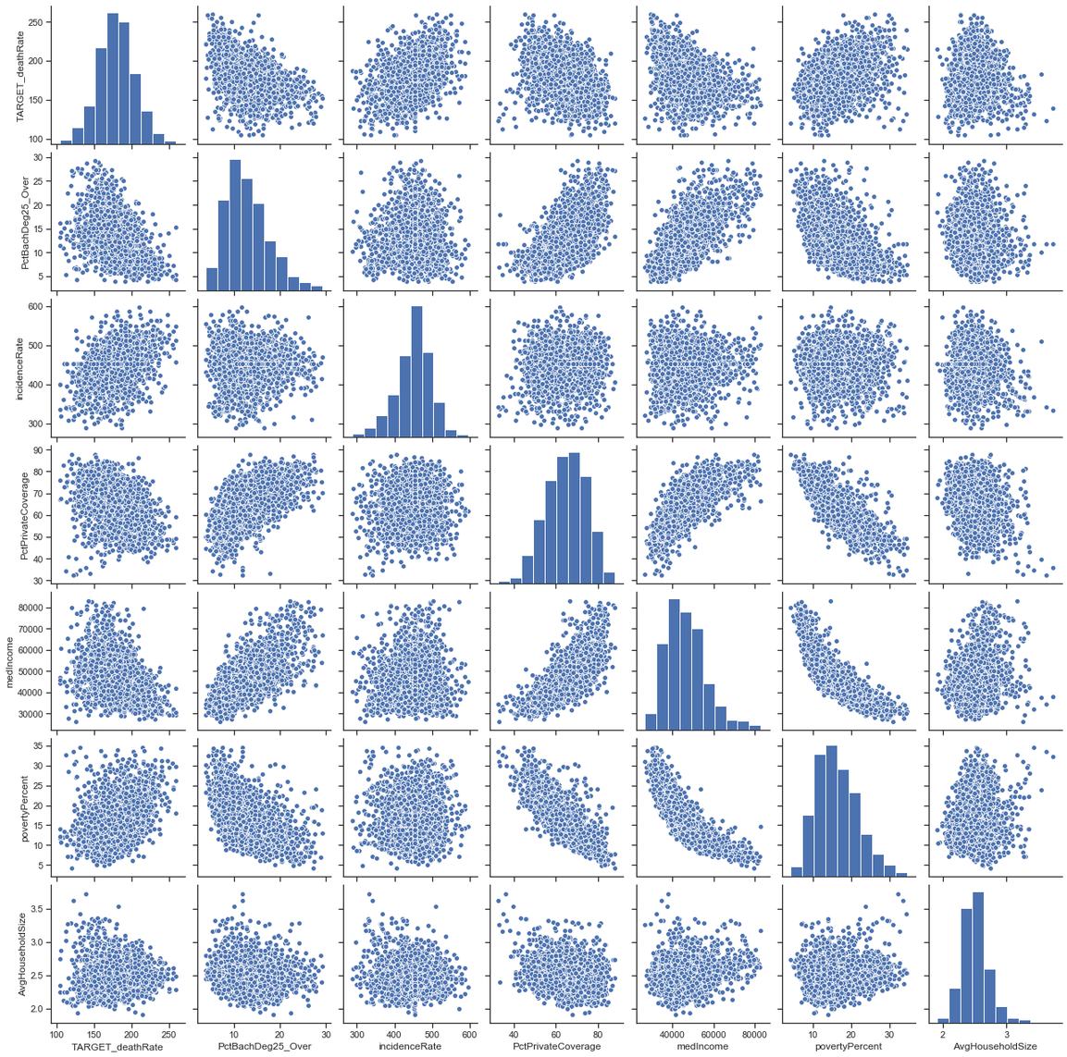
EXPLORATORY DATA ANALYSIS
Pair Plots
A pair plot of selected key variables helps identify potential relationships and possible occurence of multicollinearity.
Helpful for identifying:
Linear or non-linear relationships
Clusters or groupings
Potential multicollinearity
Outliers
These plots visually confirmed:
Positive correlation between incidenceRate and TARGET_deathRate
Negative correlation between PctBachDeg25_Over and TARGET_deathRate
9

Slide 10
EXPLORATORY DATA ANALYSIS
Age Distribution Analysis
The median age is right-skewed, indicating demographic variations across counties.
This suggests that certain counties may have a higher proportion of older adults, which could influence health outcomes.
Income Inequality Impact
Higher income inequality correlates with increased cancer mortality rates.
This suggests that disparities in income may lead to unequal access to health resources.
Access to Healthcare
Counties with better access to healthcare facilities show improved health outcomes.
This highlights the importance of healthcare infrastructure in promoting community health.
10

Slide 11
EXPLORATORY DATA ANALYSIS
Education and Mortality Correlation
Higher percentage of bachelor's degrees correlates with lower mortality rates, evidenced in scatter plots.
This indicates that educational attainment may play a crucial role in health literacy and access to healthcare.
Rural vs Urban Disparities
Rural areas face higher cancer mortality rates compared to urban counterparts, highlighting the need for targeted interventions.
Addressing these disparities is essential for equitable health outcomes.
11

Slide 12
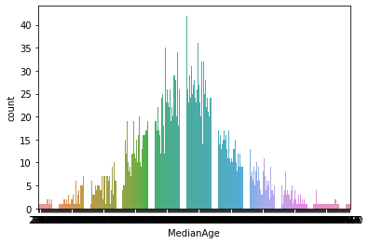
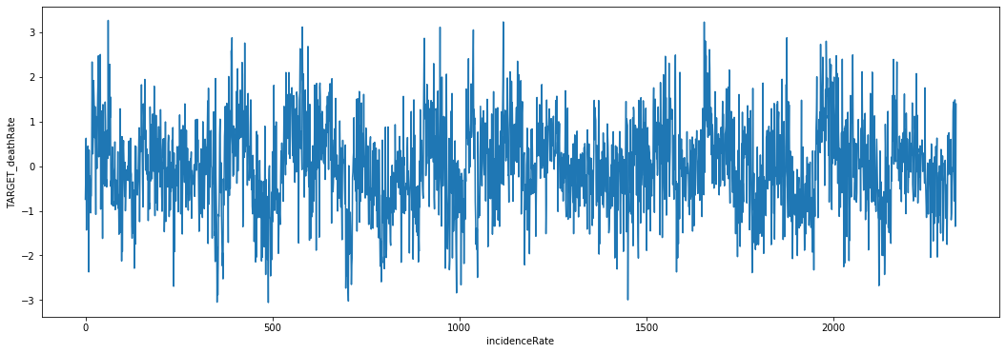
12

Slide 13
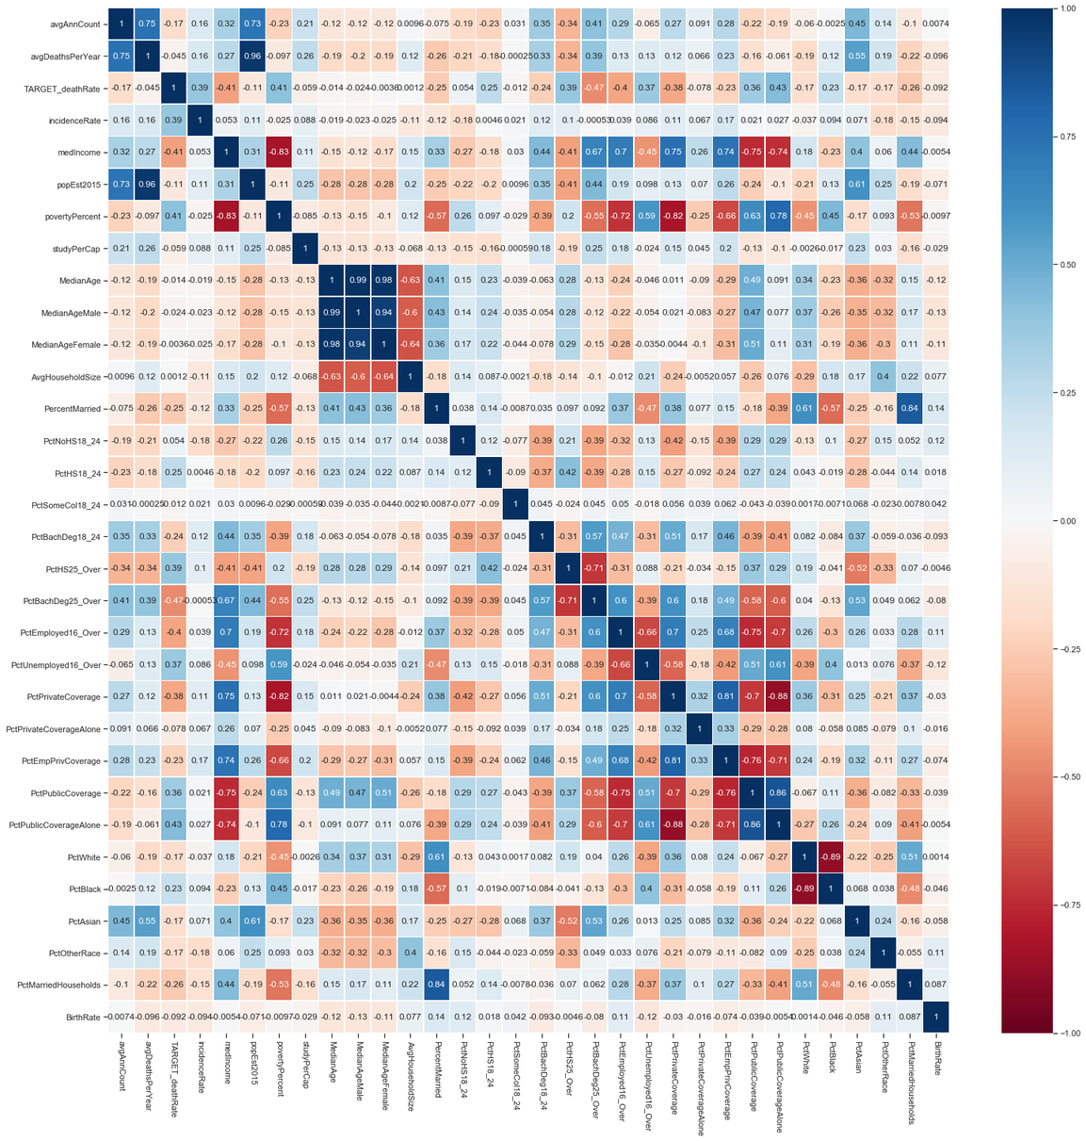
EXPLORATORY DATA ANALYSIS
MULTI COLINEARITY ANALYSIS
A heatmap is used for visual representation of the correlation matrix of numerical features in the dataset.
Purpose: To explore how different features relate to the target variable (TARGET_deathRate) and to each other before modeling.
13

Slide 14
METHODOLOGY
REGRESSION MODEL DEVELOPMENT AND EVALUATION
Experimented with several regression models to determine the best approach for predicting TARGET_deathRate.
LINEAR REGRESSION (OLS)
DECISION TREE REGRESSION
RANDOM FOREST REGRESSION
SUPPORT VECTOR REGRESSION
GAUSSIAN PROCESS REGRESSION
14

Slide 15
MODELS
LINEAR REGRESSION
Linear regression models the relationship between input features X and a continuous target variable y using a linear equation
DECISION TREE REGRESSION
A decision tree regressor is a non‑parametric, tree‐structured model that predicts a continuous (real‐valued) output by learning a set of hierarchical “if–then” rules from the features. To predict for a new sample, traverse the tree from the root, following the yes/no splits until you hit a leaf, and output that leaf’s value
RANDOM FOREST REGRESSION
An ensemble method combining multiple decision trees to improve prediction accuracy. Random Forests reduce overfitting compared to single decision trees.
15

Slide 16
MODELS
SUPPORT VECTOR REGRESSION
Support Vector Regression adapts the principles of Support Vector Machines for regression tasks, aiming to find a function f(x) that deviates from the true targets by at most ε for as many training points as possible, while keeping f as (simple) as possible. Good control over model complexity. Effective in high‑dimensional spaces
GAUSSIAN PROCESS REGRESSION
Gaussian Process Regression is a Bayesian, non‑parametric approach that places a Gaussian Process prior over the space of functions f. After observing data, we compute a posterior distribution over functions, from which you extract predictive means and variances.
A Gaussian Process (GP) is a collection of random variables, any finite subset of which is jointly Gaussian.
Fully specified by a mean function m(x) (often zero) and a covariance (kernel) function k(x,x′).
16

Slide 17
METHODOLOGY
SUMMARY COMPARISON OF MODELS
Model | R2 Score | L2 norm
Linear Regression | 0.44 | 261.52
Decision Tree | 0.28 | 336.70
Random Forest | 0.44 | 260.89
SVR | 0.43 | 266.89
GPR | 0.36 | 299.56
17

Slide 18
BLACK BOX MODELS & NEED FOR EXPLANATION
Models like SVR, Random Forest, and GPR are often labeled “black boxes” because their internal decision-making processes are not easily interpretable and require additional techniques to unpack their predictions like SHAP.
SHAP ANALYSIS
Integrating SHAP demonstrates a modern approach to interpretability. It strengthens project by providing evidence-backed insights into model behavior
18

Slide 19
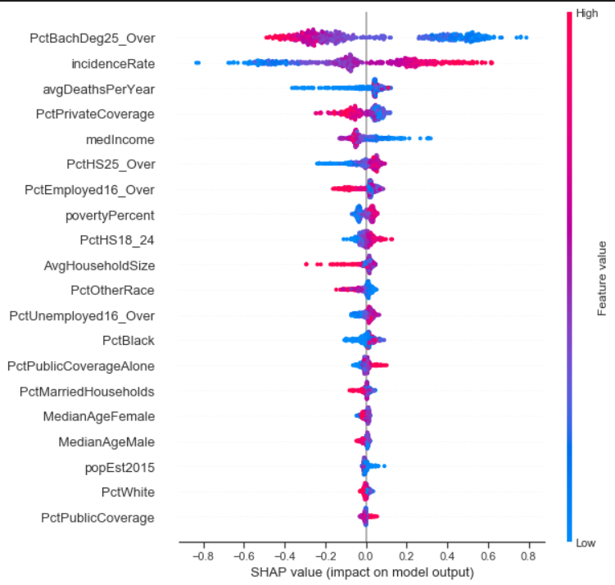
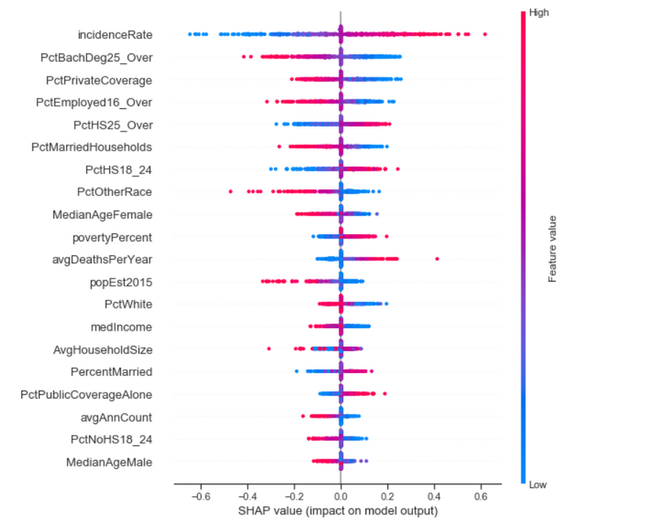
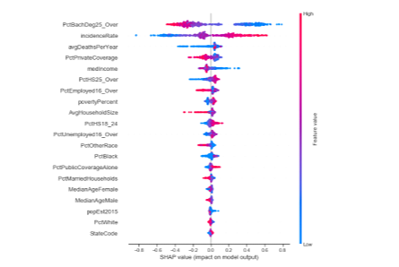
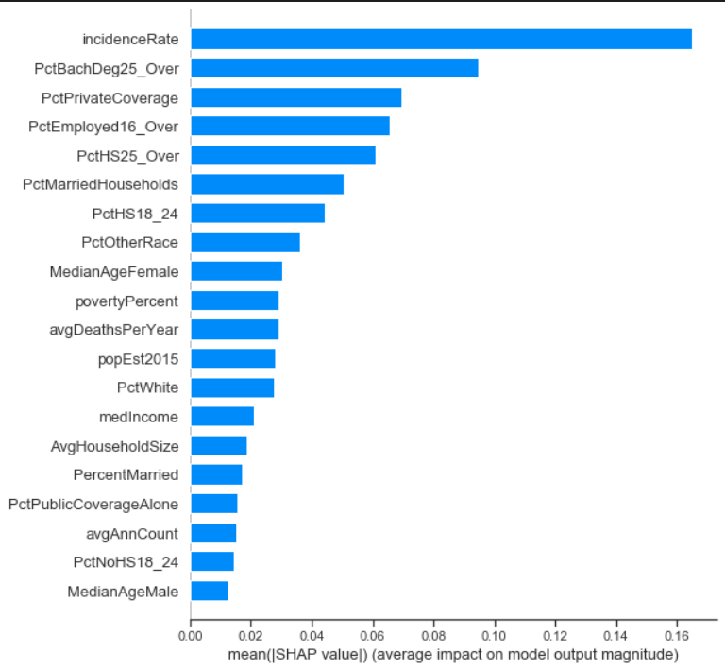
SHAP ANALYSIS-1
This is A BEE-SWARM plot made using SHAP for the SVR model showing the distribution and direction of each feature’s contributions across all samples.
X‑axis: SHAP value (impact); negative values decrease prediction, positive increase.
Each dot = one sample’s SHAP value for that feature.
Color gradient:
Blue = low feature value
Red = high feature value
Reveals:
High PctBachDeg25_Over (red dots) cluster at large negative SHAP values (reducing risk).
High incidenceRate (red) cluster at large positive SHAP values (increasing risk)
SHAP summary plots Ranks features by their average absolute impact on model predictions (global importance).
Bars sorted descending by mean(|SHAP value|).
Top features according to the summary plots are
incidenceRate(most important)
PctBachDeg25_Over
PctPrivateCoverage and PctEmployed16_Over
19

Slide 20
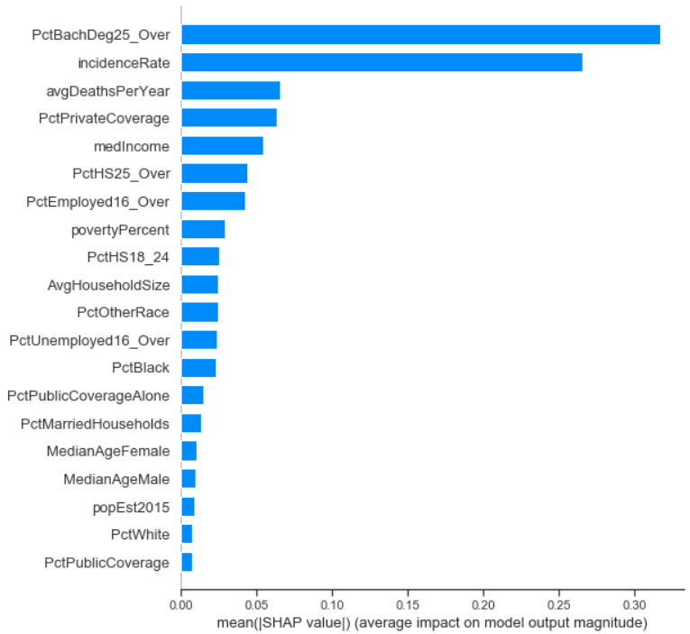
SHAP ANALYSIS-2
This is A BEE-SWARM plot made using SHAP for the Random Forest model showing the distribution and direction of each feature’s contributions across all samples.
X‑axis: SHAP value (impact); negative values decrease prediction, positive increase.
Each dot = one sample’s SHAP value for that feature.
Color gradient:
Blue = low feature value
Red = high feature value
Reveals:
High PctBachDeg25_Over (red dots) cluster at large negative SHAP values (reducing risk).
High incidenceRate (red) cluster at large positive SHAP values (increasing risk)
SHAP summary plots Ranks features by their average absolute impact on model predictions (global importance).
Bars sorted descending by mean(|SHAP value|).
Top features according to the summary plots are
PctBachDeg25_Over (most important)
incidenceRate
Features at the bottom (e.g., PctPublicCoverage, PctWhite) have minimal overall influence.
20

Slide 21
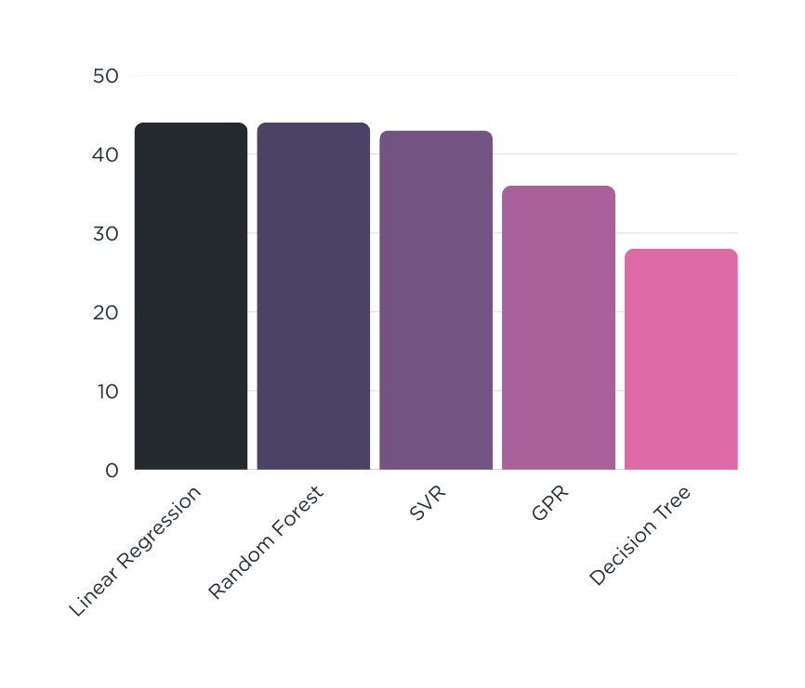
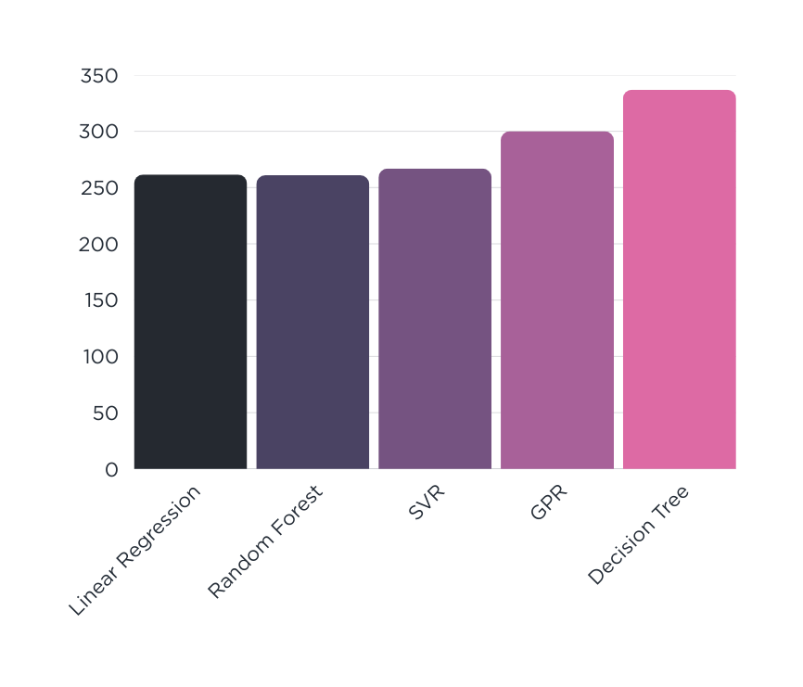
RESULT
Education, income, and access to care are strong social determinants of cancer mortality.
Ensemble methods like Random Forest offer strong predictive power with 0.44 R², but even interpretable models like OLS can be effective.
R2_Score*100
L2_Norm_Value
21

Slide 22
CONCLUSION
After a systematic data‑cleaning pipeline (3 σ outlier removal, imputation, z‑score scaling) and exploratory analysis (correlation heatmaps, scatterplots), we trained five regression models—OLS, Decision Tree, Random Forest, SVR (RBF), and GPR—and evaluated them on a held‑out test set.
We found out Random Forest Regression suits that best. We were also able to draw correlation between the socioeconomic factors and Cancer mortality
22

Slide 23
REFERENCES
U.S. Cancer Statistics (via the SEER Program)
Rasmussen, Carl Edward, and Christopher K. I. Williams.
"Gaussian Processes for Machine Learning."
MIT Press, 2006.
23

Slide 24
Thank You
24

